Slide 1

Back to Work: Navigating the New Normal During the COVID-19 Pandemic
Michael J. Torchia, Esq.
May 7, 2020
© 2020 Semanoff Ormsby Greenberg & Torchia, LLC. All rights reserved. Photocopying or distributing any portion of this publication is strictly prohibited without the prior express written permission of Semanoff Ormsby Greenberg & Torchia, LLC.

Slide 2
Timing and Scope of
Reinstating Employees

Slide 3
Reinstating Employees Now
No particular notice is required, but be practical and considerate of employee planning

Slide 4
Order of Reinstating Employees
No requirement to bring back employees in the same order or reverse order of how they were laid off (but see next section on Pitfalls)

Slide 5
Number of Reinstated Employees
No requirement to bring back all employees, BUT. . .
You may have serious Paycheck Protection Program (PPP) loan forgiveness considerations

Slide 6
PPP Loan Forgiveness and Employees
Very briefly: PPP loan forgiveness is based on what business spends in eight week period after receiving funds. Forgiveness is reduced by (1) the number of full-time equivalent employees you have now versus a prior period; and (2) the amount of wages you are paying now versus a prior period. Also, you may maximize forgiveness if by June 30th you have the same number of FTEs as a prior period.

Slide 7
PPP Loan Forgiveness and Employees
Recommendation: Immediately speak with your attorney or accountant (they need to be well-versed in the CARES Act and the PPP) about how best to maximize forgiveness using the many often-contradictory provisions of the PPP.

Slide 8
Pitfalls When Reinstating Employees

Slide 9
Discriminating Against Employees
Age, race, disability, gender, pregnancy, etc.
Recommendation: document the reasons and develop written criteria based on non-discriminatory factors

Slide 10
Hiring or Replacing Employees
Are you hiring new rather than reinstating employees? Why?
Recommendation: document the reasons and develop written criteria based on non-discriminatory factors

Slide 11
Seniority And Other Rights
Under collective bargaining agreement
Recommendation: review the CBA, confer with Business Agent; consult policies

Slide 12
Wage and Hour/FLSA Concerns
Non-exempt employees still get overtime
Exempt employees still get paid for an entire week if they work any part of it, with exceptions

Slide 13
Wage and Hour/FLSA Concerns
Exempt employees may convert to non-exempt if performing non-exempt work
Employees still can’t be treated as independent contractors

Slide 14
Employers Can’t Require
Certain Employees To Return To Work
ADA: Employees out for a COVID-19 or other disability-related reason
FMLA: Employees on FMLA for a non-COVID-19 related reason

Slide 15
Employers Can’t Require
Certain Employees To Return To Work
Employees on military leave
Employees on vacation?
Employees on workers’ comp

Slide 16
Employers Can’t Require
Certain Employees To Return To Work
If employee is qualified for the FFCRA (Families First Coronavirus Response Act) which has the EPSLA (Emergency Paid Sick Leave Act) and the EFMLA (expanded FMLA)

Slide 17
FFCRA Refresher
Effective April 1 through Dec. 31, 2020
EPSLA: Six reasons to be out for up to two weeks. (2/3 daily rate capped at $200/day; or full daily rate capped at $511/day)
EFMLA: One reason to be out for up to an additional ten weeks. (2/3 daily rate capped at $200/day)

Slide 18
FFCRA Refresher
Employer cannot force other benefits prior to FFCRA – employee choses order of benefits
Employers with 25 or more must reinstate employee after EFMLA; under 25 no requirement if employee was out due to child care or position eliminated
Business reimburses itself for 100% of the FFCRA benefits paid by keeping social security payroll taxes.

Slide 19
FFCRA Small Business Exception
Small business exception for less than 50 employees exempt only from child care benefits, only if an authorized officer of the business has determined that:
  1. The provision of paid sick leave or expanded family and medical leave would result in the small business’s expenses and financial obligations exceeding available business revenues and cause the small business to cease operating at a minimal capacity;
  2. The absence of the employee or employees requesting paid sick leave or expanded family and medical leave would entail a substantial risk to the financial health or operational capabilities of the small business because of their specialized skills, knowledge of the business, or responsibilities; or
  3. There are not sufficient workers who are able, willing, and qualified, and who will be available at the time and place needed, to perform the labor or services provided by the employee or employees requesting paid sick leave or expanded family and medical leave, and these labor or services are needed for the small business to operate at a minimal capacity.

Slide 20
Employee Refusal: Unemployment
“I’m making more on unemployment than working”
Employee can be left on furlough, reduced hours, disciplined or fired; unemployment notified of voluntary resignation

Slide 21
Employee Refusal: Unemployment
“I’m making more on unemployment than working”
Recommendation: direct them in writing to return by a certain date and provide clear consequences for not returning

Slide 22
Employee Refusal: Unemployment
By the way, an employer does not have an affirmative obligation to contact the unemployment job center and report the rehiring of employees. The employee does.

Slide 23
Employee Refusal: Fear
“I’m scared I’ll catch the virus”
Recommendation/Part 1:
    Medical certification?
    Work it out with employee through accommodations?
    Special case such as health condition or family situation?

Slide 24
Employee Refusal: Fear
Recommendation/Part 2:
Employee can be left on furlough, reduced hours, disciplined or fired; unemployment notified of voluntary resignation

Slide 25
Employee Refusal: Fear
Recommendation/Part 3:
Document the circumstances
Ask employee to sign a statement
Provide clear consequences in writing to employee
Make certain the business has complied with current local, state and federal health and safety guidelines

Slide 26
Employee Refusal: Ramifications
It’s unknown how unemployment will view employee refusal – as a voluntary resignation?
It’s unknown whether firing would be “wrongful termination” in violation of public policy (but it’s doubtful)
Notes:
Assuming you don’t want to take a hard line (and jump right to #2 below), we suggest trying to both convince and accommodate the employee. Can the employee work at different times (come in very early or very late to avoid most others)? have a separate work area? Continue to work from home? Work different days (such as the weekends even)? You can educate the employee on all the great steps you’re taking to try and keep everyone safe. Unfortunately, all of that may not work and the employee may still refuse.
An employee who is being directed to return to work but will not can remain on furlough, or be disciplined or be fired. What is unknown at this time, is whether an employee who refuses to work because they’re scared of catching coronavirus will be able to collect unemployment (most people believe the employee will not be able to collect and it will be considered a voluntary quit). Also unknown is whether the employee will be able to claim wrongful discharge – but for some detailed legal reasons, I don’t believe the employee would have such a claim in Pennsylvania.

Slide 27
Best Practices for the Return
Provide reasonable notice of the return to work date
Advise if permanent or temporary
Advise of salary level
Advise of change of duties

Slide 28
Best Practices for the Return
Advise of health and safety measures
Provide “Return to Work Plan”

Slide 29
Best Practices for the Return
Think twice! And be flexible.
Many requirements, deadlines, obligations, etc. have been changed or extended (e.g. COBRA payments and deadlines, tax deadlines, borrowing from 401(k) and many more)

Slide 30
Unknown: Employer Liability
Going Forward
Direct violation of governmental health and safety directives (fines or penalties)
OSHA complaints
Whistleblower actions
Workers’ comp claims
Negligent hiring or retention of employee claim

Slide 31
Health and Safety Considerations

Slide 32
PA Health and Safety Directives
PA Department of Health Order of April 15th and FAQs updated on April 27th
Together, the directives cover people working for both life-sustaining and non-life sustaining businesses

Slide 33
PA Health and Safety Directives
Requires (“shall”) implement:
Cleaning and disinfecting protocols
Staggering start, break and stop times
Social distancing (at least 6 ft.)
Virtual meetings and 10 person limit
Employee access to cleaning supplies
Masks provided by employer except eating or drinking
Sufficient employees to implement
Prohibiting non-essential visitors
Employee notice of these procedures
Other set of requirements for retail

Slide 34
PA Health and Safety Directives
Requires measures “upon discovery that the business has been exposed to a person who is a probable or confirmed case of COVID-19”:
Close off areas, open windows, disinfect various surfaces
Identify employees in close contact and take measures depending on symptoms, send home if symptomatic
Implement temperature screening upon entering work
Employees with symptoms must notify supervisor and stay home and follow CDC guidelines for self-quarantine

Slide 35
PA Health and Safety Directives
Additional set of requirements for retail
Additional set of requirements for construction, especially those issued on April 23rd.
No current expiration except for “red–yellow–green” phases.

Slide 36
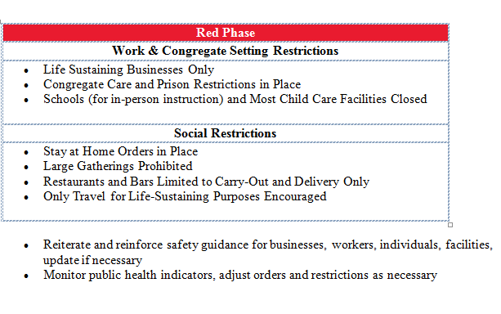
PA Health and Safety Directives

Slide 37
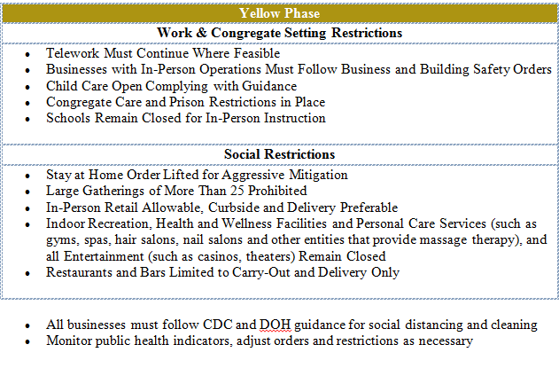
PA Health and Safety Directives

Slide 38
Note that in the “Yellow” Phase. . .
“Telecommuting must continue where feasible”
Many businesses remain closed including personal care services, recreation and entertainment
So in yellow, you still may be working from home with long hair, chipped fingernails and desperate to go bowling!

Slide 39
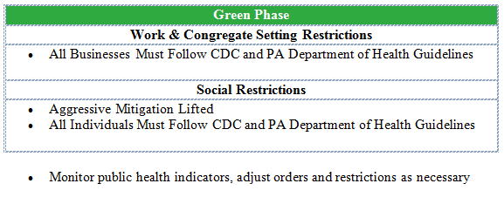
PA Health and Safety Directives

Slide 40
NJ Health and Safety Directives
Business FAQ page is updated daily and the last Executive Order pertaining to businesses was issued April 11 (EO 125)
The NJ Governor has not issued a re-opening plan, however, a plan will be based on “SIX PRINCIPLES TO RESTORE ECONOMIC HEALTH THROUGH PUBLIC HEALTH”:
🏠Sustained reductions in new #COVID19 cases & hospitalizations
🔬Expand testing capacity
👥Implement robust contact tracing
🏥Secure safe places for isolation
🏢Responsible economic restart
📋Ensure NJ’s resiliency
The NJ Governor did not say which businesses would be able to reopen first or with what precautions, only that essential businesses in low-risk categories would have priority.

Slide 41
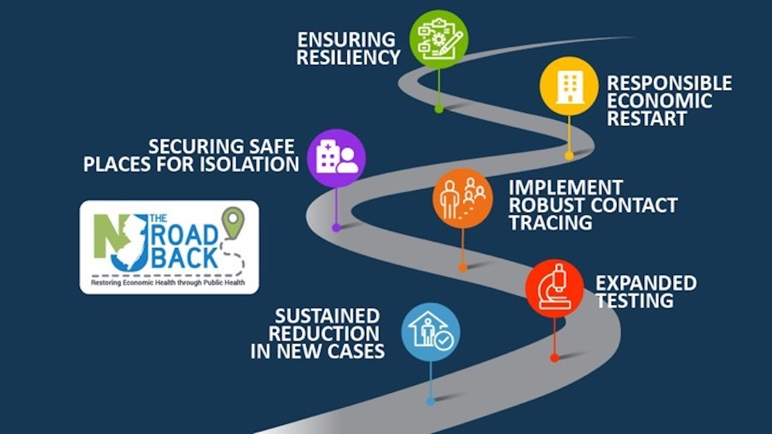
NJ Health and Safety Directives

Slide 42
Health and Safety of Returning Employees
Can we fire employees who have the coronavirus?

Slide 43
Health and Safety of Returning Employees
Can we ask employees to stay home if we suspect they have been exposed to coronavirus?

Slide 44
Health and Safety of Returning Employees
Can we ask employees to inform us if they have come in contact with someone who has or is suspected to have coronavirus, or is quarantined?

Slide 45
Health and Safety of Returning Employees
Upon return to work, are we required to allow employees to take their sick, vacation, or PTO time?

Slide 46
Health and Safety of Returning Employees
Can we tell other employees about an employee who has or may have coronavirus?

Slide 47
Health and Safety of Returning Employees
If there is a vaccine, can we require our employees to get it?

Slide 48
Health and Safety of Returning Employees
Can we require employees to get an antibody test before returning to work?

Slide 49
Health and Safety of Returning Employees
Can we require employees to wear masks or gloves?

Slide 50
Health and Safety of Returning Employees
Can we prohibit employees from wearing masks or gloves?

Slide 51
Health and Safety of Returning Employees
Can we impose travel restrictions? What if the employee’s duties are to travel, e.g. sales?

Slide 52
Health and Safety of Returning Employees
Can we prevent visitors and guests from our premises if we believe they have coronavirus, or otherwise?

Slide 53
Health and Safety of Returning Employees
Is the company liable if someone catches the virus?

Slide 54
Return to Work Plan

Slide 55
Return to Work Plan
Written plan to all employees that lays out the following (although a writing is not required):
Timing of the return
Describe phases of return if applicable
Employee screening upon return
Health and safety protocols upon returning
Employee responsibilities
Contact persons at the company for questions or concerns
Statement that the Plan is subject to change without notice
Employee acknowledgment of receipt

Slide 56
Return to Work Plan
The Return to Work Plan does not take the place of other required or usual documents, such as medical certifications, FMLA paperwork, company policies, employee contracts, or a CBA.
If the Return to Work Plan is in writing, make sure it complies with all governmental directives!

Slide 57
Any questions?

Slide 58
Back to Work: Navigating the New Normal During the COVID-19 Pandemic
Michael J. Torchia, Esq.
May 7, 2020
© 2020 Semanoff Ormsby Greenberg & Torchia, LLC. All rights reserved. Photocopying or distributing any portion of this publication is strictly prohibited without the prior express written permission of Semanoff Ormsby Greenberg & Torchia, LLC.

